Slide 1



Slide 2

“Boundary Layer in Fluid Dynamics”
Presentation on

Slide 3

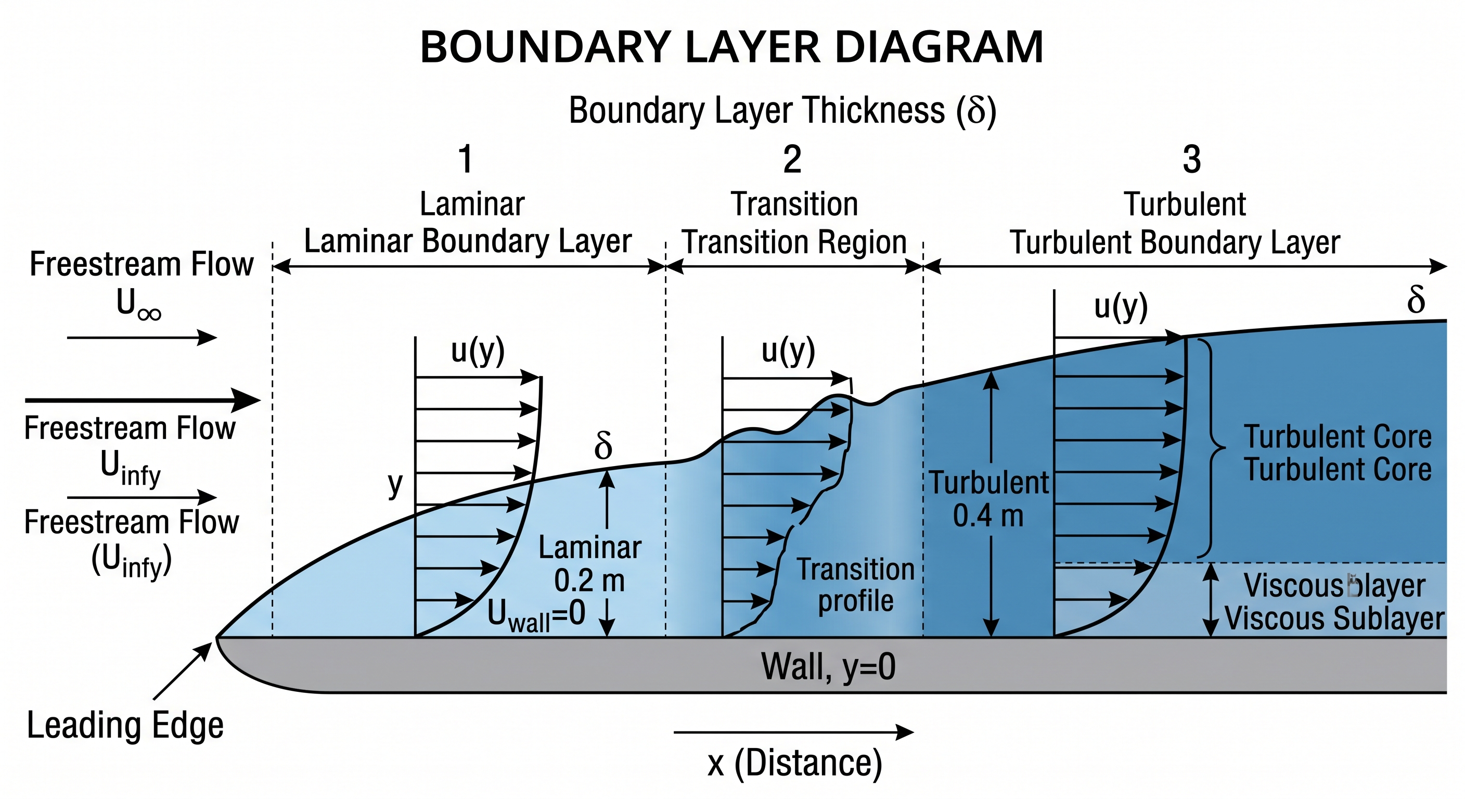
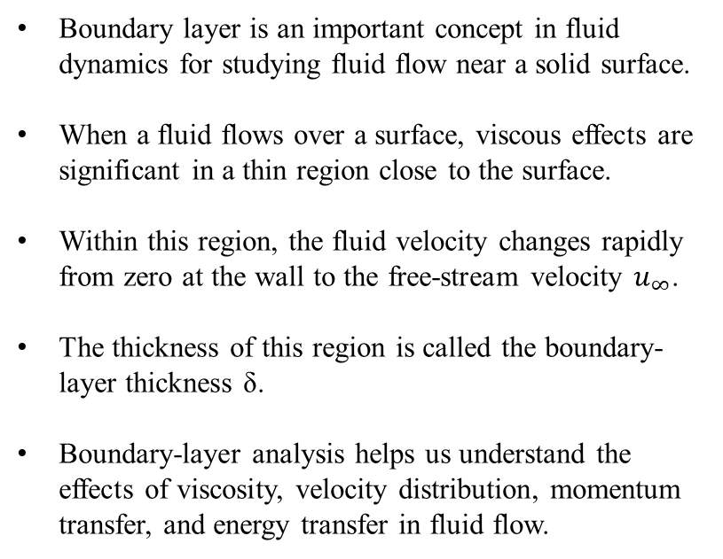
Introduction
Boundary layer is an important concept in fluid dynamics for studying fluid flow near a solid surface.
When a fluid flows over a surface, viscous effects are significant in a thin region close to the surface.
Within this region, the fluid velocity changes rapidly from zero at the wall to the free-stream velocity $u_{∞}​$.
The thickness of this region is called the boundary-layer thickness δ.
Boundary-layer analysis helps us understand the effects of viscosity, velocity distribution, momentum transfer, and energy transfer in fluid flow.

Slide 4

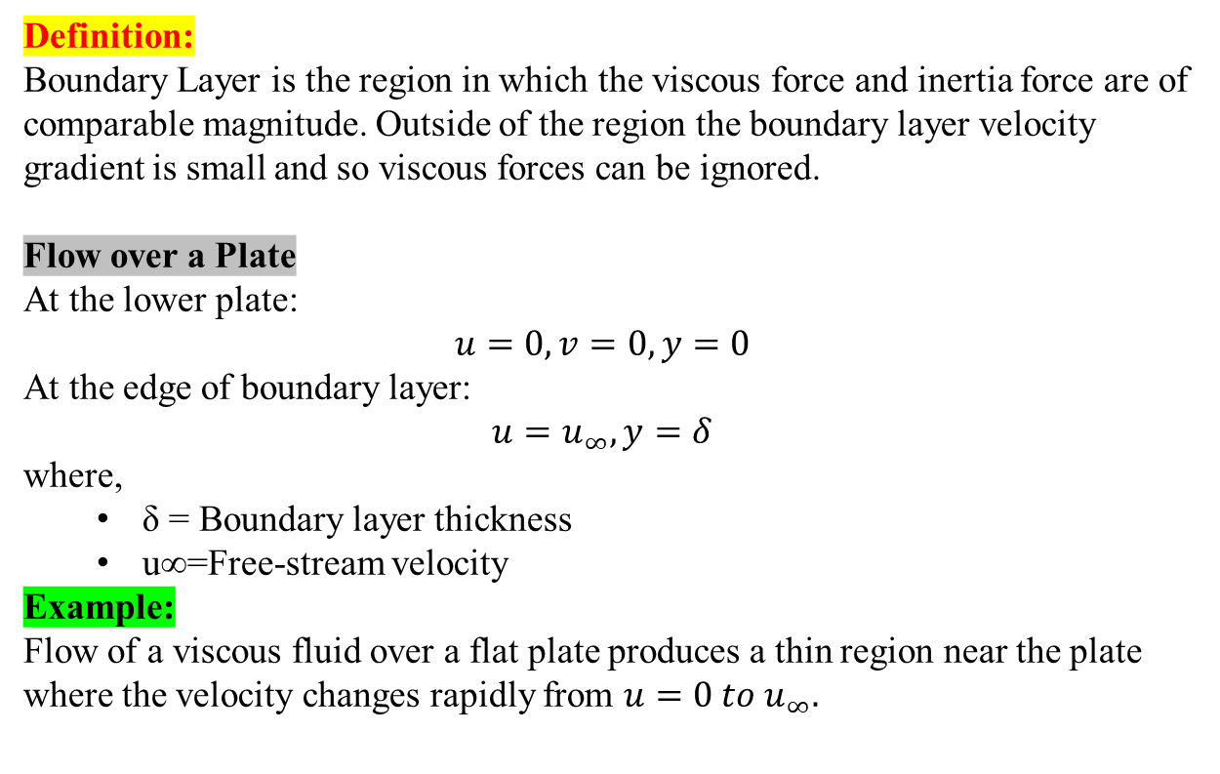
BOUNDARY LAYER
PART 04
Definition:
Boundary Layer is the region in which the viscous force and inertia force are of comparable magnitude. Outside of the region the boundary layer velocity gradient is small and so viscous forces can be ignored.
Flow over a Plate
At the lower plate:
$$u=0,v=0,y=0$$
At the edge of boundary layer:
$$u=u_{∞}​,y=δ$$
where,
δ = Boundary layer thickness
u∞​=Free-stream velocity
Example: Flow of a viscous fluid over a flat plate produces a thin region near the plate where the velocity changes rapidly from $u=0 to u_{∞}​.$
PART 03
PART 01
PART 02

Slide 5

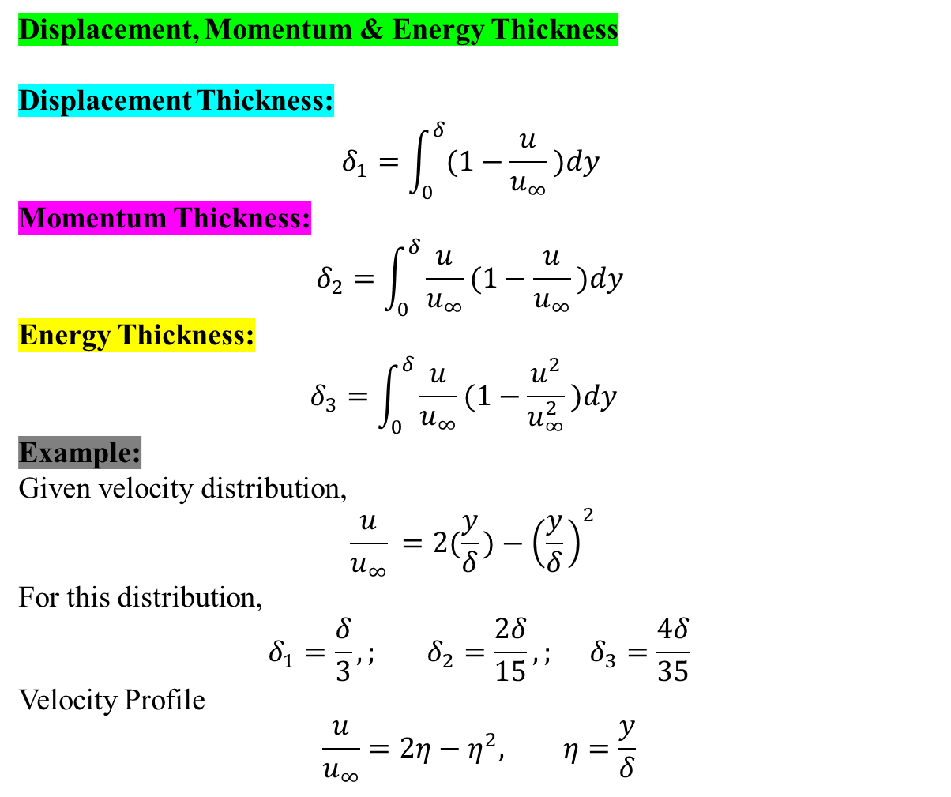
BOUNDARY LAYER THICKNESSES
PART 04
Displacement, Momentum & Energy Thickness
Displacement Thickness:
$$δ_{1}​=\int_{0}^{δ}{(1−\frac{u}{u_{∞}}​​)dy​ }​$$
Momentum Thickness:
$$δ_{2}​=\int_{0}^{δ}{\frac{u}{u_{∞}}(1−\frac{u}{u_{∞}}​​)dy​ }$$
Energy Thickness:
$$δ_{3}​=\int_{0}^{δ}{\frac{u}{u_{∞}}(1−\frac{u^{2}}{u_{∞}^{2}}​​)dy​ } ​$$
Example:
Given velocity distribution,
$$\frac{u}{u_{∞}}​​=2(\frac{y}{δ}​)−{\left(\frac{y}{δ}​​\right)}^{2}​$$
For this distribution,
$$δ_{1}​=\frac{δ}{3}​,; δ_{2}​=\frac{2δ}{15}​​,; δ_{3}​=\frac{4δ​​}{35}$$
Velocity Profile
$$\frac{u}{u_{∞}}=2η−η^{2}, η=\frac{y}{δ}$$
PART 03
PART 01
PART 02

Slide 6


Summary
PART 04
Boundary Layer
A boundary layer is the region where viscous force and inertia force are of comparable magnitude. Outside this region, the velocity gradient is small, so viscous forces can be neglected.
Important Points
At the plate: $u=0,v=0$
At the edge: $u=u_{∞}​, y=δ$
δ = boundary-layer thickness
$u_{∞}​$= free-stream velocity
Three Important Thicknesses
Displacement thickness: $δ_{1}$​
Momentum thickness: $δ_{2}$​
Energy thickness:${ δ}_{3}\text{​}$
Overall: Boundary-layer analysis describes how velocity changes near a solid surface and uses displacement, momentum, and energy thickness to quantify its effect.
PART 03
PART 01
PART 02

Slide 7


